Slide 1
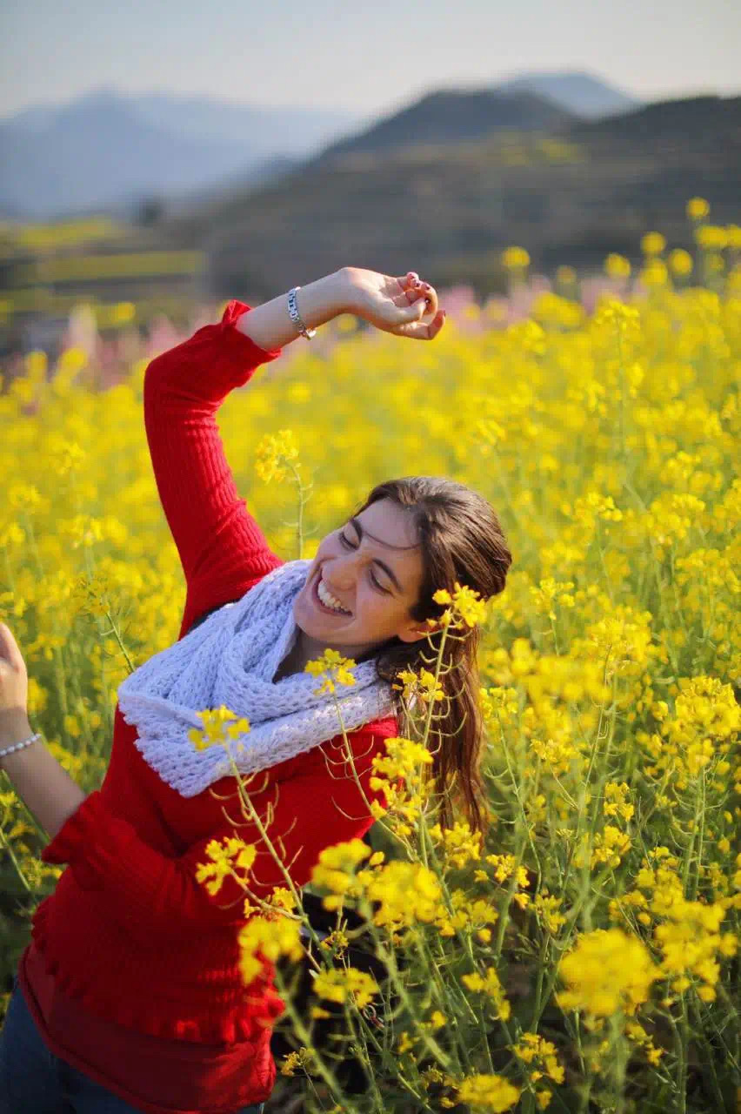
SLACK
LOOK FOR / UNICORNS BOX / fuzhishan

Slide 2
魔盒物语
【Magic box Tales】
音符梯田花海轻漫步，攀石浪觅金色梦探古村
UNICORNS BOX’s Tales : Melodies of Terraced Blooms, Golden Dreams Amidst Ancient Stones
/
《覆卮山》这片江南水乡中的秘境，得名于东晋时代诗人谢灵运。作为上虞区的最高峰，覆卮山仍保留着至少五百多年历史的梯田，这些梯田全部由第四纪冰川遗迹——“石冰川”中的岩块砌筑而成，构成了一幅奇诡壮丽的图画。蜿蜒在梯田之间的是古老的山间古道，它们见证了千年的农耕文明与地质变迁。
Fuzhi Mountain, a hidden gem in the watery landscapes of Jiangnan, draws its name from Xie Lingyun, a renowned poet of the Eastern Jin Dynasty. As the highest peak in Shangyu District, it preserves terraced fields crafted over 500 years ago from boulders of the Quaternary glacial relics—known as "stone glaciers"—forming a surreal and majestic panorama. Winding through these terraces are ancient mountain trails that whisper tales of millennia-old agrarian heritage and geological marvels.

Slide 3


Slide 4
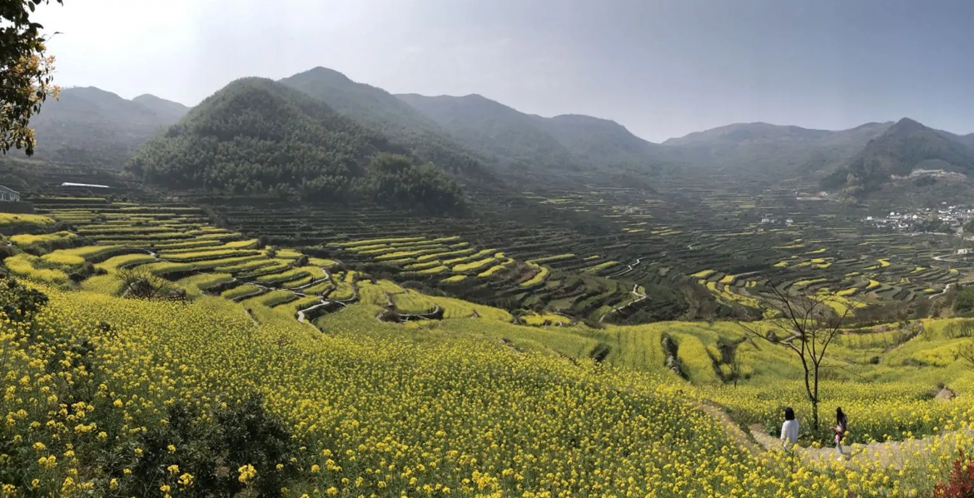
文化
亮点
【Key Highlights】
千年梯田·见证金色农耕文化
不是婺源，却藏着江南最磅礴的梯田油菜花海！由冰川遗迹岩块垒砌。2300亩金黄从山腰铺泻而下。
Millennia-Old Terraced Fields · Guardians of Golden Agrarian Heritage
Though not Wuyuan, it boasts the most magnificent seas of rapeseed blossoms in Jiangnan! Built with glacial relics, 2,300 acres of golden blooms cascade down the mountainside like liquid sunlight.

Slide 5
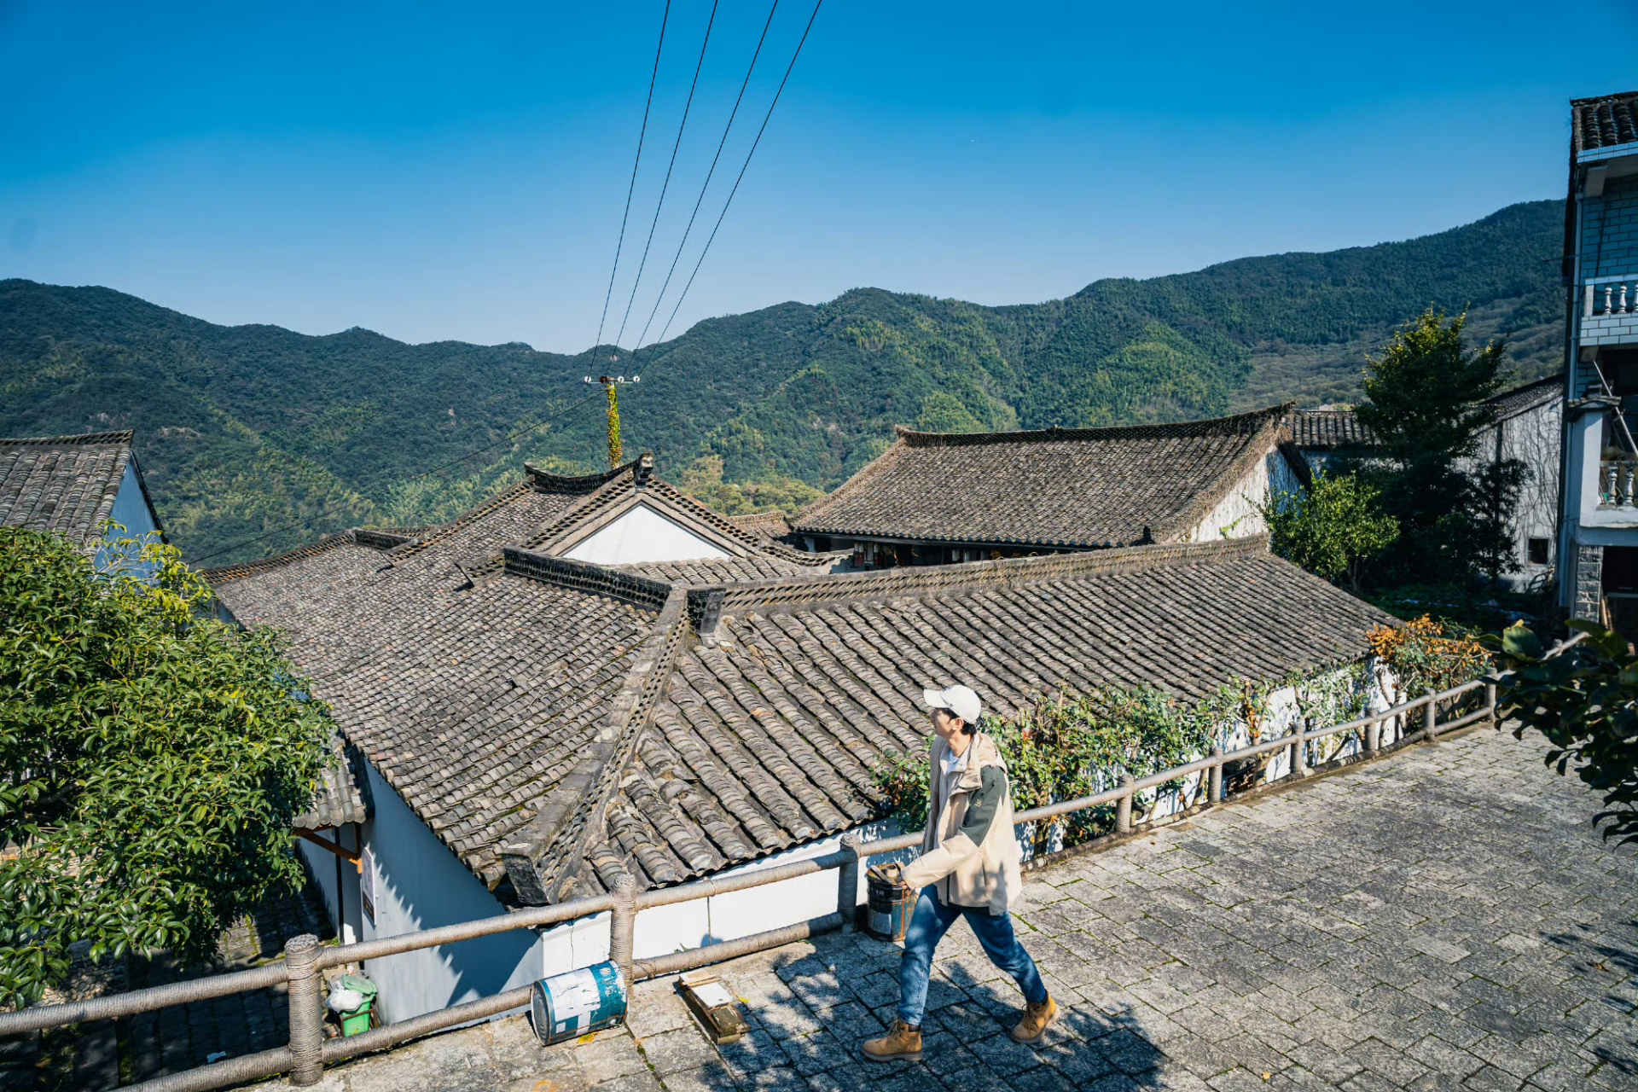
百年古村·徒步山居生活秘境
青石板路蜿蜒，穿过梯田与竹林，黛瓦石墙间藏着百年山居生活图景。
Touching 2.9 million years of geological epic, adventure meets wonder.
Century-Old Villages · Hiking Through Mountain
Life’s Hidden Chronicles
Follow cobblestone paths that wind through terraced fields and bamboo groves. Discover centuries of mountain life etched into slate roofs and stone walls.

Slide 6
《覆卮山》北坡的冰川石浪，堪称地文奇观。天然的乱石滚滚如浪，故名石浪，形成于约3百万年的四纪早期，大规模的古冰川运动，因此造就了奇特的石冰川群。覆卮山及周边山区，有大浪、小浪、梅浪、乌浪、响石浪等大小12条石浪。是我国低纬度、低海拔地区发现的规模最大的石浪群。介于苕花岭乌浪和梯田旁边的丁山响石浪之间。多条石浪相汇为一，石浪滚滚如河。

Slide 7
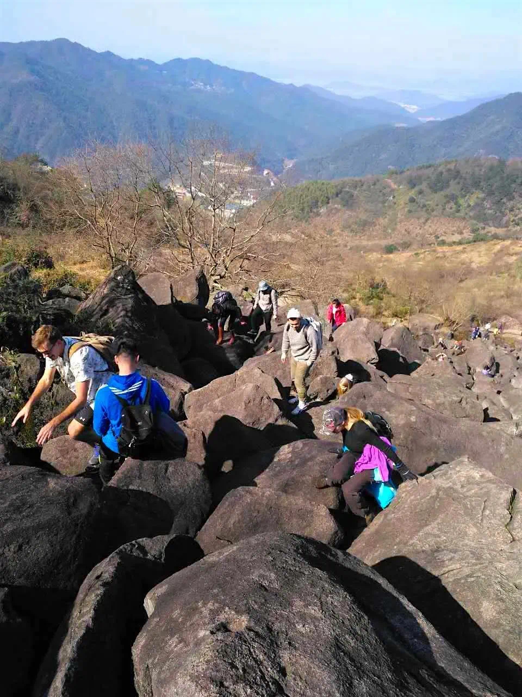
The glacier waves on the northern slope of
Fuzhi Mountain can be called a geological wonder. Natural rocks roll like waves, hence the name Shilang, formed in the early Quaternary period about 3 million years ago.
The large-scale movement of ancient glaciers has
created a unique group of stone glaciers.
There are 12 stone waves of various sizes, including Dalang, Xiaolang, Meilang, Wulang, Xiangshilang, etc., found in low latitude and low altitude areas of China in Fuzhishan and surrounding mountainous areas
The largest group of stone waves.
Between Tiaohualing Wulang and Dingshan
Xiangshilang
next to the terraced fields.
Multiple stone waves converge into one, r
olling like a river.

Slide 8
【程与诚】
Itinerary: Journey of Sincerity
07:00 | 宜山路集合
07:00 | Gather at Yishan Road
07:30｜启程追光，上海出发-嘉绍大桥服务区-绍兴覆卮山-途径枫泾服务区（休息25min）有餐食咖啡
11:45｜抵达山下村落徒步点
这是一个被梯田环绕的古老村子
12:45｜巨石浪亭间歇息，进行路餐（请自备午餐）
15:30｜到达山顶，享受山顶资本吧！
18:00｜结束旅程，返回上海
07:30｜Depart Shanghai, chasing the morning light.
Route: Shanghai → Jiaxing-Shaoxing Bridge Service Area → Fengjing Service Area (25-minute break; dining and coffee options available) → Fuzhi Mountain, Shaoxing
11:45｜Arrive at the trailhead village
An ancient village cradled by terraced fields
12:45｜ Rest at Stone Wave Pavilion
Picnic lunch (please bring your own meals) amidst the primordial rock formations.
15:30｜ Summit triumph
Take in the panoramic views from the 861-meter peak—your reward for the climb.
18:00｜Conclude the journey, return to Shanghai, carrying memories of golden fields and ancient stones.

Slide 9
魔盒
惊喜
WE: UNICORNS BOX
我们将为各位热爱户外朋友们精心设计户外精途魔法线，不断推出「盲盒惊喜主题单元、文化艺术、免费盲盒名额、盲盒礼品、双语环境，中外交友并肩同行，专业及安全服务相伴」独角兽携手大家一起守护正能量与纯洁。
WE:
We will carefully design outdoor magic lines for outdoor enthusiasts, continuously launching "surprise themed blind box units, cultural arts, free blind box quotas, blind box gifts, bilingual environment, Chinese and foreign friends walking side by side, professional and safe services accompanying" unicorns to protect positive energy and purity together with everyone.
purity and sharing positive energy!

Slide 10
purity and sharing positive energy!

Slide 11
【盒子消息】
[Box message]
线路全长：13KM，累计爬升约960m
Total length of the route: 13km, with an elevation
gain of approximately 960m
预计时长：6H
Estimated duration: 6H
难度：中等难度
Difficulty level: Medium
风景度：五颗星
Scenic rating: Five Stars
难度：入门 风景度：四颗星
Quota: Free and Discounted Blind Box
Gift: Peripheral Gifts

Slide 12
【费用信息】[Cost Information]
交通：舒适豪旅大巴，司机路桥燃油停车等费用
物资：配备应急医疗物资
服务：全程双语领队，活动策划组织费用，
人身保障：户外高额30w保险
Transportation: Comfortable luxury bus, driver's
road and bridge fuel parking fees, etc
Material: Equip with emergency medical supplies
Service: Full bilingual team leader, activity planning
and organization fees,Personal protection: Outdoor
high-value 300000 yuan insurance
【注】[Note]
行程通知：最晚在出行前1天给您发送，如未收到请联系
工作人员。集合时间、地点、服务人员等信息以《行程通知》为准。
预定限制：请有心脑血管疾病、心脏病史、孕妇及其余身体不
便的人士避免参加户外徒步活动，请8～55岁之外的老人及
未成年人在有监护人员的情况下参与，并将同行情况
提前报备。
活动装备：本次活动为轻装徒步，建议携带登山杖、防滑鞋等基础装备。
需带宠物提前讲，并支付50元清洁费。
Travel notification: We will send it to you no later than 1
day before departure. If you have not received it, please
contact our staff. The gathering time, location, service
personnel and other information shall be subject to the
"Travel Notice".
Reservation restrictions: Individuals with cardiovascular and cerebrovascular diseases, a history of heart disease, pregnant
women, and others with physical disabilities are advised to
avoid participating in outdoor hiking activities. Elderly and
minors aged 8-55 are required to participate with a guardian
and report their travel status in advance.
Event equipment: This event is a light hiking, and it is r
ecommended to bring basic equipment such as hiking poles
and anti slip shoesPets must be brought in advance and
a cleaning fee of 50 yuan must be paid

Slide 13

【魔盒环保】
UNICORNS BOX’s LOVE
保护户外生态环境，请大家敬畏自然，不轻狂。让我们携手共创美好爱心box文明团，共勉之！
To protect the outdoor ecological environment, please respect nature and not be reckless. Let's work together to create a lovely and caring UNICORNS BOX Team, and encourage each other!

Slide 14

Unicorns BOX
Art nouveau
独角兽的魔盒
/
新艺术运动
your kingdom
你 的 王 国

